Slide 1
Smart Automatic emergency battery operated LED Street lights
Presented by-
. DEVESH SINGH NEGI ,2012975 . SARTHAK DEB ,2012980. SAGAR RATURI , 2012945.
SAUMAY RANJAN , 2012946.
SEC-A ,8TH SEM ,2021.
Presented to-
Dr.GAURAV MITTAL
Mr.PARITOSH MISHRA
ADVISOR- DR.D.B.SINGH

Slide 2
CONTENTS
.ABSTRACT
. Objective
.Block Diagram
.Hardware Equipments
. Working (Circuit design)
.Components
Advantages
Disadvantages
Applications
.Literature survey
.References

Slide 3
Abstract
This automatic emergency led light is used at night in the time of emergency when the power is cut-off by some reason . This emergency light takes 230V AC and it converts it into 12V DC and also charges the battery which is used in this circuit.
The battery is used at that time when the power is cut off or we need to use it. This light is used mostly in villages because there is lack of electricity.

Slide 4
OBJECTIVE
The light turns on automatically when the mains fails and shuts down when power resumes.
It has its own office. When the battery is fully charged, the charging stops.

Slide 5
CONVENTIONAL STREET LIGHTS
HID lamps are a category of electrical gas remittance lamp which bring forth light by means of an electric arc in middle of tungsten electrodes resided inside a translucent or crystalline fused quartz or inter fuse alumina arc tube. Gas and metal salts are recycled to permeate the tube. The arc’s fundamental opening is done with the benefit of gas. Once the arc is initialized, it heats and disperse the metal salts materializing plasma, the plasma thus generated greatly boosts the concentration of light emitted by the arc and power consumption is curtailed. Arc lamps belongs to the category of high intensity exoneration lamps.

Slide 6
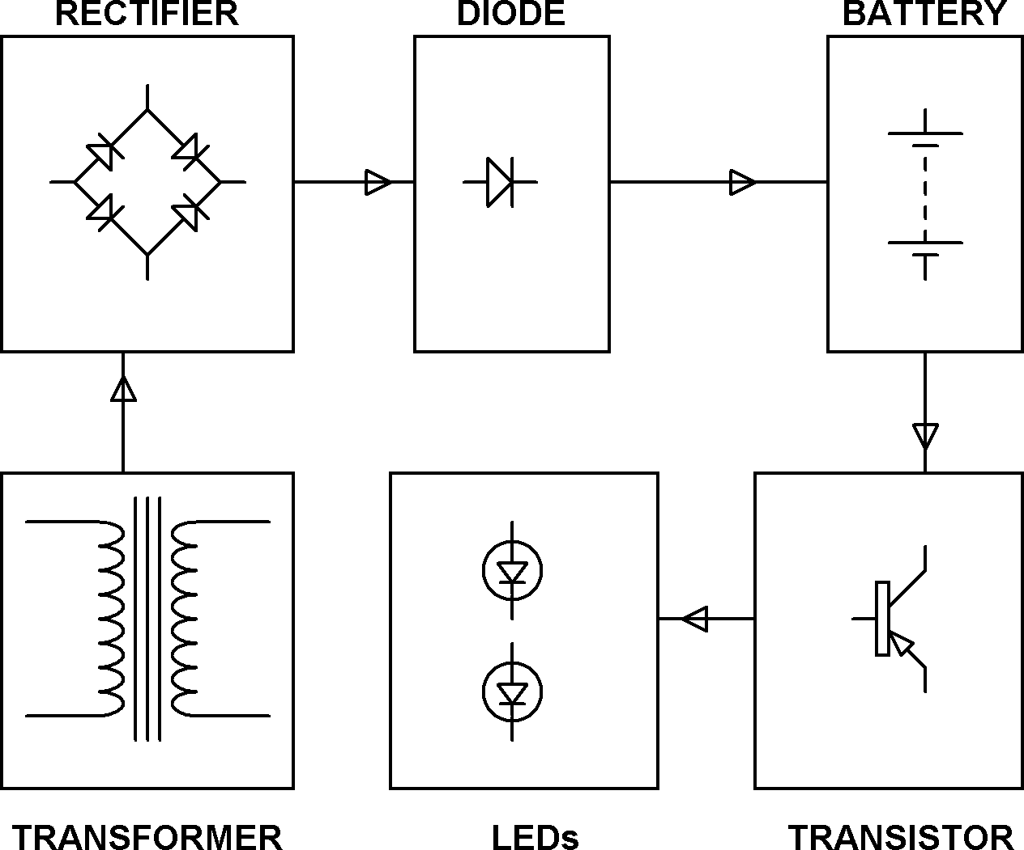
BLOCK DIAGRAM

Slide 7
HARDWARE EQUIPMENTS
Transformer(230V-12V AC)
Rectifier(1N4007 Diodes)
Filter(1mF capacitor)
Voltage Regulator(LM317)
Transistors(BC547,BD140)
Diodes(1N4007)
Resistors(16,100,180,1K,1.2K)
Zener Diode
LED(5mm white LED)
Rechargeable Battery

Slide 8
Working of the system.
The Current is taken from the mains and the AC supply is taken to the transformer to decrease the voltage and passed to the rectifier to convert it into DC supply which is stored in the battery that can be used in case of emergency(flood ,Cut-off) and then transferred to rectifier to control or regulate the flow of electronic signals and then the light is on.

Slide 9
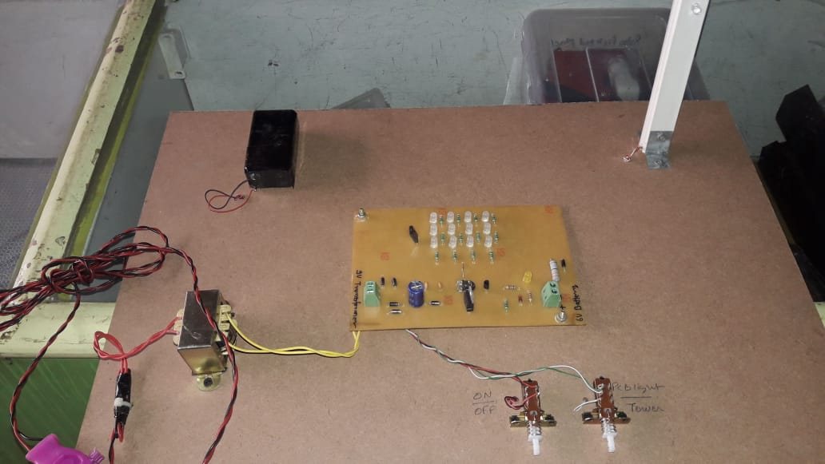
ACTUAL WORKING MODEL OF THE SYSTEM (T0P VIEW)

Slide 10
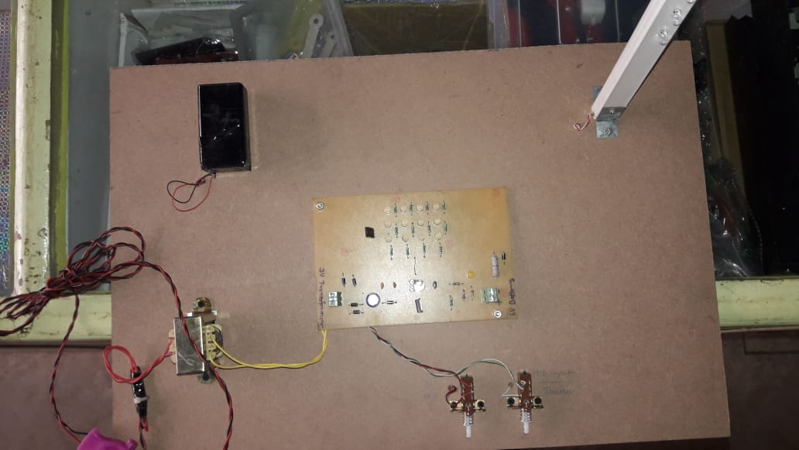
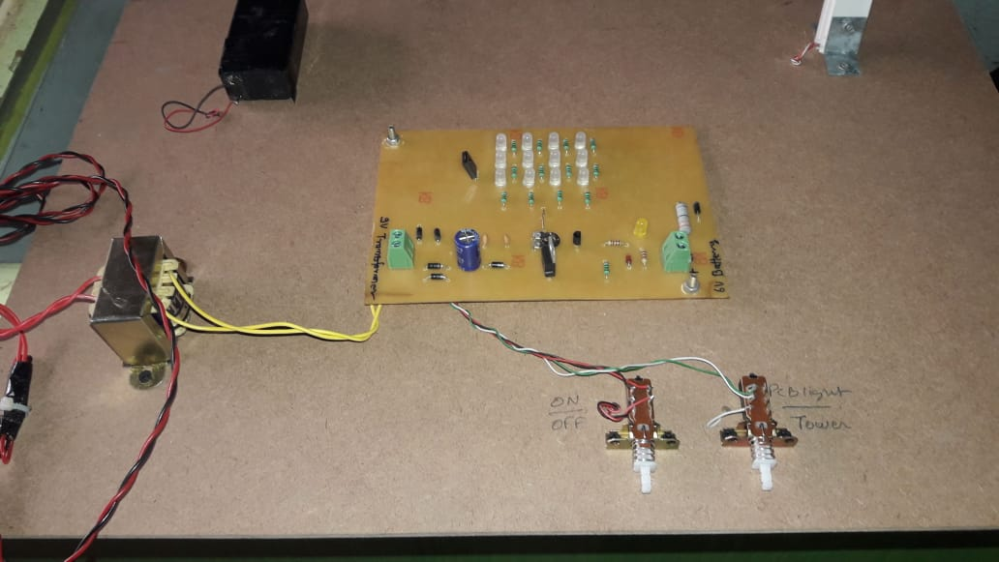

Slide 11
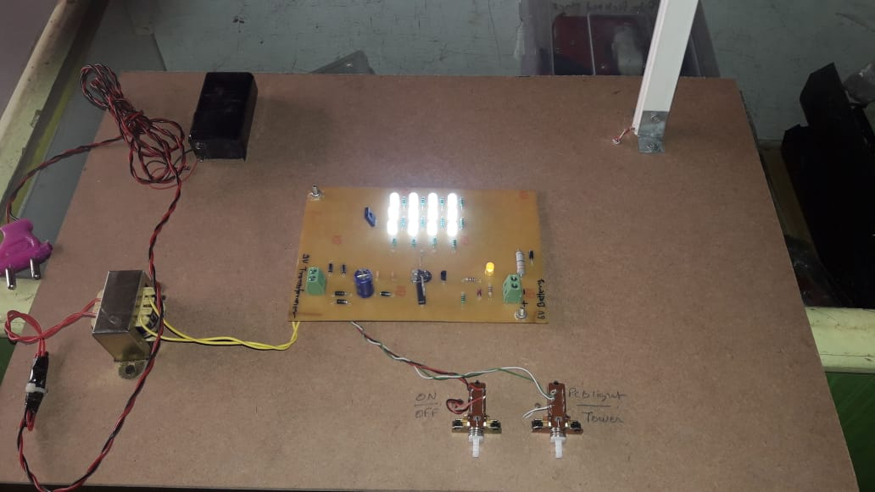
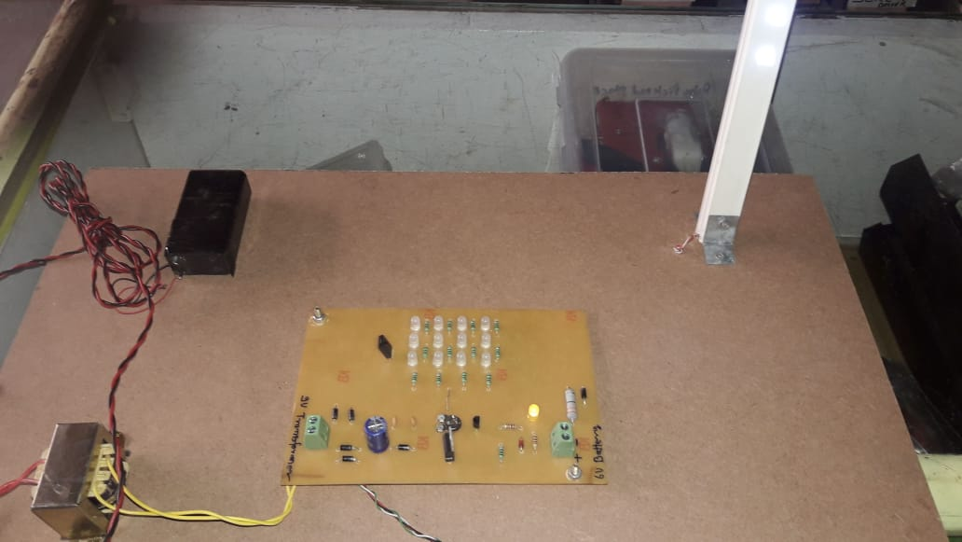

Slide 12
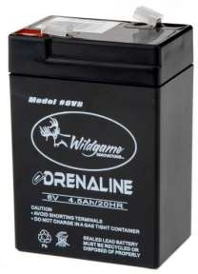
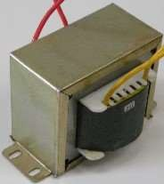

COMPONENTS
TRANSFORMER-It step downs the voltage from 230v-9v AC .
BRIDGE RECTIFIER- It converts 9v AC to 9v DC. There are four 1N4007 diodes used to form a bridge.
RECHARGEABLE BATTERY-A 6v 4.5Ah lead acid battery is used to give as o/p.

Slide 13
TRANSISTOR- 1) BC547 is an NPN bi-polar junction transistor. Its mainly used for amplification and switching purposes. It has a maximum current gain of 800.
2) BD140 is a PNP bi-polar transistor. Its mainly used for medium power linear switching.

Slide 14
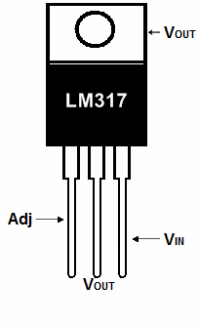
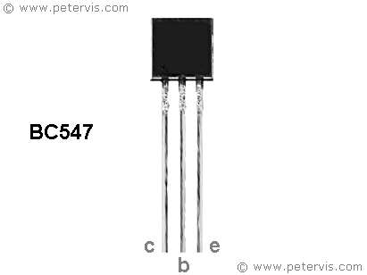
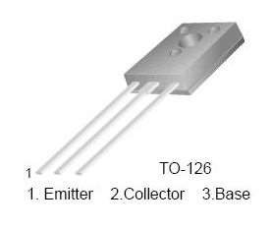
VOLTAGE REGULATOR- LM317 device is an adjustable three-terminal positive-voltage regulator capable of supplying more than 1.5 A over an output-voltage range of 1.25 V to 37 V.

Slide 15
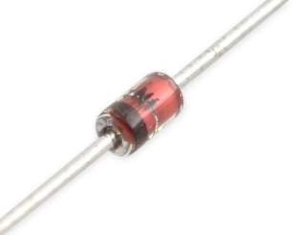
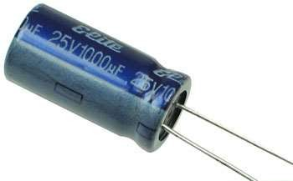
ZENER DIODE- Zener diodes are widely used in electronic equipment of all kinds. They are used to generate low power stabilized supply rails from a higher voltage and to provide reference voltages for circuits, especially stabilized power supplies.
FILTER- Capacitor c1 is used as a filter because capacitors easily pass AC (changing) signals but they block DC (constant) signals. Here it is used to eliminate ripples.

Slide 16
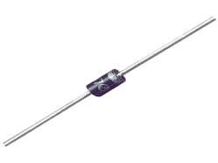
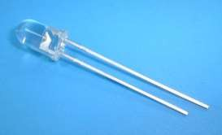
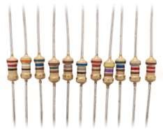
DIODE- a diode is a two-terminal device that conducts primarily in one direction. Diode 1N4007 has lower voltage drop & high surge current capability.
LED- Twelve 5mm high luminous intensity white LED lights are used having forward voltage(Vf)=3-3.6v & forward current of 30mA.
RESISTORS- Various resistors of value 16,180,100,1k,2.2k are used to reduce current flow & voltage levels at various points in the circuit.

Slide 17
ADVANTAGES
Saves fuel.
Measurable environmental impact due to reduced energy consumption.
Easy to use.
Huge reduction of energy and maintenance cost.
Easy to install anywhere
ON/OFF time is quick.
Safer traffic due to increased visibility of hazards.

Slide 18
DISADVANTAGES
It can be used only for short period.
Cool white LEDs can cause problems to eyes.
In case of defect or repair, troubleshooting of the system is complex.
Implementation cost is high.

Slide 19
Applications
Used in street light applications
Used in domestic applications.
Smart street lights could be equipped with radar sensors which could detect if any object comes near the pole and the light gets brighter.
It can be used as a digital signage.

Slide 20
FUTURE SCOPE.
Uses at conference room, exhibition hall lighting.
Uses at Direction arrow board for bathroom.
Long lasting battery that works for approx. 8 hrs.
Automatic LED can be used for mass production as cheap & efficient method.

Slide 21
LITERATURE SURVEY:-
Sagar Deo, Sachin Prakash, Asha Patil- In their research paper we got to know about the analysis of the intelligent control light system usually bring about the programming of arduino ,sensors the calculations based on it and how we will use these upcoming and latest technology in our day to day life.
2)A. Gil-de Castro, A. Moreno-Munoz, A. Larsson, J. de la Rosa, and
M. Bollen-Their paper describes about the zig bee network which I have explained above thoroughly and the use of zig bee network in controlling the smart led control light system through clouds and servers which people found a great method to show authorized user. The authorized user can also launch requests.
3)H. Zhang, J. Burr, and F. Zhao, “A Comparative Life Cycle Assessment (LCA) of Lighting Technologies for Greenhouse Crop Production –their paper elaborates the design and construction of automatic street light control system circuit .Circuit works properly to turn street lamp On/Off .After designing the circuit which controls the light of the street as illustrated in the section.

Slide 22
REFERENCES(WEBSITES)
www.google .com
https://www.hackster.io
Building the internet of things by Maciej Kranz
electricalnotes.file.wordexpress
sciencedirect.com
IEEE.ORG
www.atmel.com
www.beyondlogic.org
www.wikipedia.org
www.howstuffworks.com
www.alldatasheets.com

Slide 23


Slide 24
ANY Queries?

